Slide 1


Team Work Assignment
Notes:
.

Slide 2


Single Player game
Fastest is the best
Discover all empty squares
Avoid all mines
Notes:
Find the empty squares while avoiding the Mines. The faster you clear the board , the better you score !

Slide 3
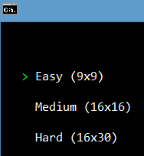
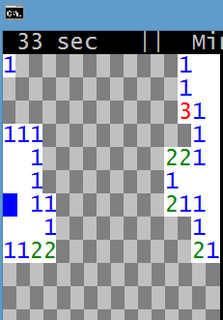
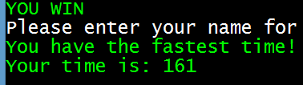
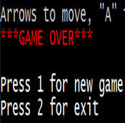
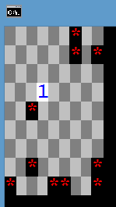
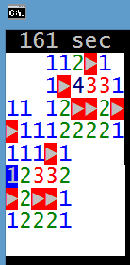
MINESWEEPR GAMEPLAY
Dificalty
Emptyfileds
WINGAME
GAME OVER

Slide 4

LIVE DEMO
PLAY ME

Slide 5


TEAM
Velimira Madjarova
user : velimira.madjarova
Pavleta Taseva
user : pavleta
Decho Dechev
user : decho.D
Mihail Yankov
user : M.Yankov
Kiril Borisov
user : borisov.kiril760
Ivan Kitanovski
user : ivank0900
Niko Tsonev
user : Kambocha
user : DobryG
Dobromir Ganev

Slide 6

QUESTIONS

